Slide 1
PPT on Salient Features of the Constitution of India

Slide 2
Salient features of the Constitution of India
Written Constitution
The Constitution is a complete written document that includes the constitutional law of India.It took 2 years, 11 months and 18 days for the constitution to be written and implemented.The Constitution of India has 225 Articles divided into 22 parts with 12 schedules and 104 constitutional amendments.

Slide 3
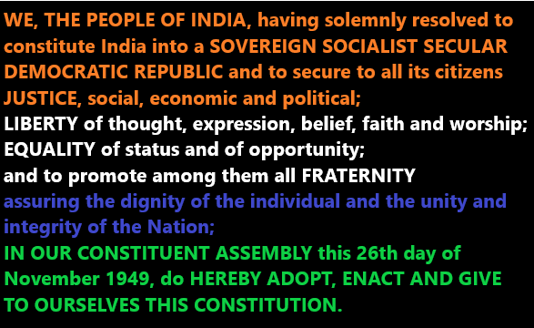
Preamble of the Constitution
The preamble of the Indian Constitution states the philosophy of the Constitution.

Slide 4
Secularism
India is a secular state. secularism means the institution of government is separated from religion. Secularism does not mean that there is no religion in the state but it does mean that all religions and all citizens of that religion have the right to spread and preach the religion of their choice. The word ‘secular’ was included in our preamble by the 42nd Amendment,1976 of the Indian Constitution.

Slide 5
Democracy
India is the largest democracy in the world. After independence in 1947, India became a democratic nation. India is a federal parliamentary democracy in which the President of India is the head of state and the Prime Minister of India is the head of government.The main reason for choosing democracy is to give people the freedom to choose their representatives and protect them from oppressive leaders.

Slide 6
Quasi-Federal
It has been a subject of debate among scholars whether the Constitution of India is fully federal or unitary in nature. But it is a combination both.
Federal Salient features of the Constitution of India
Dual polity
Written and Rigid Constitution
Supremacy of the Constitution
Division of powers
Bicameral Legislature
Independent judiciary
Unitary Features of the Indian constitution
Constitutional amendment procedure
All India Services.
Emergency provisions
Single Citizenship:
A Strong Centre:
Single Constitution for Union and States
Thus the Indian Constitution can be described as quasi-federa

Slide 7
Fundamental Rights
Fundamental rights are the most important feature of the Indian Constitution.Fundamental rights are rights that are essential for the intellectual, moral and spiritual development of individuals.
There are six fundamental rights recognised by the Indian constitution:
Right to equality (Articles. 14-18)
Right to Freedom (Articles. 19-22)
Right Against exploitation (Articles. 23-24)
Right to Freedom of Religion (Articles. 25- 28)
Cultural and Educational Rights (Articles. 29-30), and
Right to Constitutional Remedies (Articles. 32-35)

Slide 8
Directive Principles of State Policy
The concept of Directive Principles of State Policy was derived from the Irish Constitution. The purpose of Directive Principles of State Policy is to create a ‘welfare state’.Directive Principles of State Policies are not enforceable in a court of law.
List of Directive Principles of State Policy
Article 36 – Definition of the state
Application of the principles contained in this Part The provisions contained in this Part shall not be enforceable by any court,- Article 37–
Article 38– State to secure a social order for the promotion of welfare of the people
Article 39– Certain principles of policy to be followed by the State
The organisation of village panchayats -Article 40
Article 41- Right to work, to education and to public assistance in certain cases
Article 42 – Provision for just and humane conditions of work and maternity relief
A living wage, etc, for workers – Article 43
Article 44– Uniform civil code
Article 45– free and compulsory education for children
Educational and economic interests of Scheduled Castes, Scheduled Tribes and other weaker sections – Article 46
Article 47– Duty of the State to raise the level of nutrition and the standard of living and to improve public health
Article 48– Organisation of agriculture and animal husbandry
Protection of monuments and places and objects of national importance – Article 49
Article 50– Separation of judiciary from executive
Article 51-Promotion of international peace and security
51A-Fundamental duties

Slide 9
Parliamentary System
Democracy can be of two types; President Democracy and Parliamentary democracy. India has a parliamentary system of government. Article 74 and Article 75 of the constitution of India relate to the parliamentary system at the centre . Indian Parliamentary system is bicameral in nature. It consists of the President and two Houses – Lok Sabha and Rajya Sabha. The Council of Ministers is responsible to the Parliament.

Slide 10
Independence of Judiciary
Independence of Judiciary is one of the pillars on which the rule of law exists. The process of appointing judges also guarantees the judiciary independence in India.The Supreme Court and High Court judges are appointed by the President.
The constitution has made the following provisions to ensure independence of judiciary.
Appointments of Judges
Control over Establishment
Security of Tenure
No discussion in Legislature on the conduct of Judges
Separation of judiciary from the executive
Prohibition on practice after retirement – Article 124 (7)

Slide 11
Hierarchy of Courts in India and The Justice System in India
Supreme court of India
High Courts
District and Session courts
Chief Judicial Magistrate/CJSD
Judicial Magistrate First Class /CJJD

Slide 12
Thank You

